Slide 1
Loan Default Case

Slide 2
Business Understanding/Deployment
Goal: Maximize Profit for a Bank
Ideas to Proceed?
Identify the customers who would be least likely to default.
Choose a threshold that will help banks to maximize profit
Deployment
Providing the tool/model that will help banks screen customers more efficiently
2

Slide 3
Data Understanding/Preparation
122 features (number of original features) ; 54 features (post-cleaning)
307,511 observations (number of customers in the dataset); 182,322 observations (post cleaning)
Target Variable:
Defaulter (yes/no)
Features/Attributes:
Demographics( gender/ age/ family status, etc)
Financial Standing (income, previous loan history, loan amount requested)

Slide 4
Modeling
Determine the likelihood that a customer will default
Which core data mining task?
* Classification
Which data mining method?
Logistic Regression with Lasso
Random Forest
Gradient Boosting Classifier
XG Boost Classifier

Slide 5
Steps and Evaluation
Hyper Parameter Tuning using Grid Search Cross Validation
Modelling using the best parameters.
Cross Validation in the training dataset.
Holdout 34000 sample of observations.
Performance Metric to consider:
1. Accuracy
2. AUC
3. Profit Maximization

Slide 6
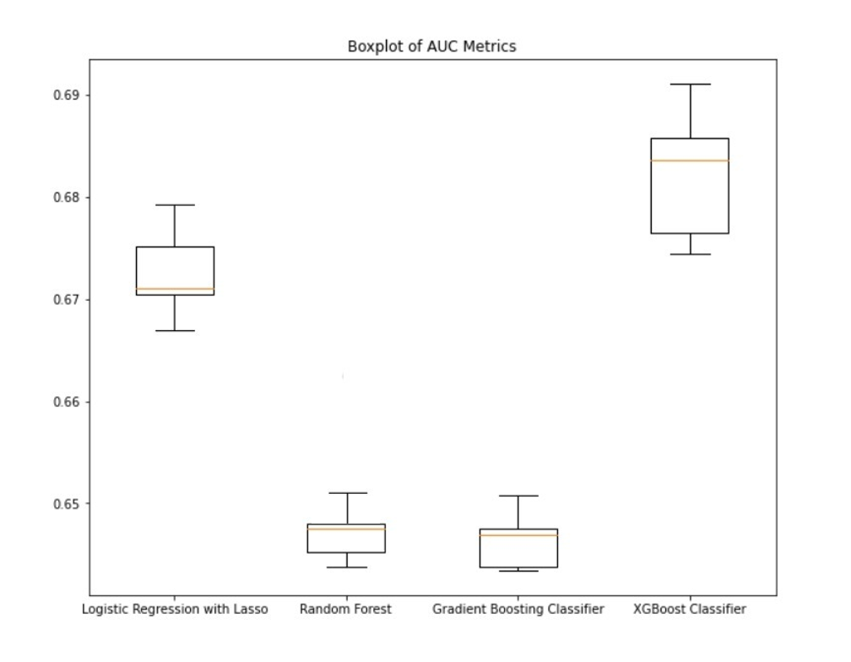
Evaluation: Cross Validation
Hence, we will choose XGBoost Classifier model

Slide 7
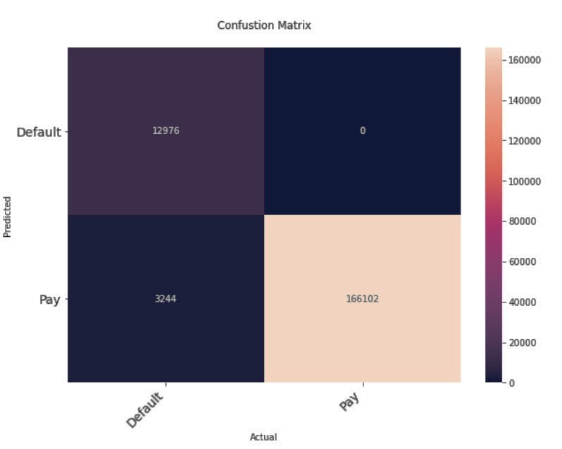
Model Performance: Confusion Matrix
True positive rate and false positive rate:
𝐹𝑎𝑙𝑠𝑒 𝑝𝑜𝑠𝑖𝑡𝑖𝑣𝑒 𝑟𝑎𝑡𝑒 = 0/(0+166102) = 0%.
𝑇𝑟𝑢𝑒 𝑝𝑜𝑠𝑖𝑡𝑖𝑣𝑒 𝑟𝑎𝑡𝑒 =12976/(12976+3244) = 80%
As per the confusion matrix, we have a true positive rate of 80% and a false positive rate of 0%.

Slide 8
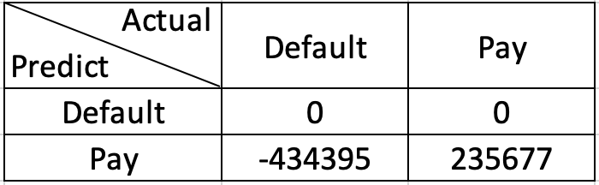
Model Performance: Cost-Benefit Matrix
The average gain:
𝑠𝑢𝑚(𝑅𝑒𝑣𝑒𝑛𝑢𝑒−𝑙𝑜𝑎𝑛 𝑎𝑚𝑜𝑢𝑛𝑡)/𝑛𝑢𝑚𝑏𝑒𝑟 𝑜𝑓 𝑐𝑙𝑖𝑒𝑛𝑡 = 434395
The average loss:
𝑠𝑢𝑚(−0.7×𝐿𝑜𝑎𝑛 𝐴𝑚𝑜𝑢𝑛𝑡)/𝑛𝑢𝑚𝑏𝑒𝑟 𝑜𝑓 𝑐𝑙𝑖𝑒𝑛𝑡 = -235677
Expected Profit:
[Expected profit per customer| Loan] = 235677 * Probability (Repayment) – 434395 * Probability (Default)

Slide 9
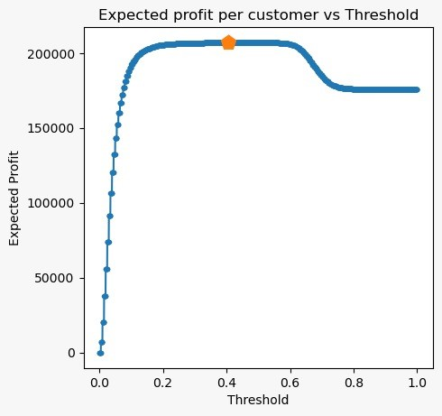
Visualizing Model Performance
Profit Curves
What is the optimal threshold?
Based on our analysis we recommend that the user picks a threshold of 0.4 to maximize their profit. This suggestion takes into account assumptions as stated.

